Slide 1
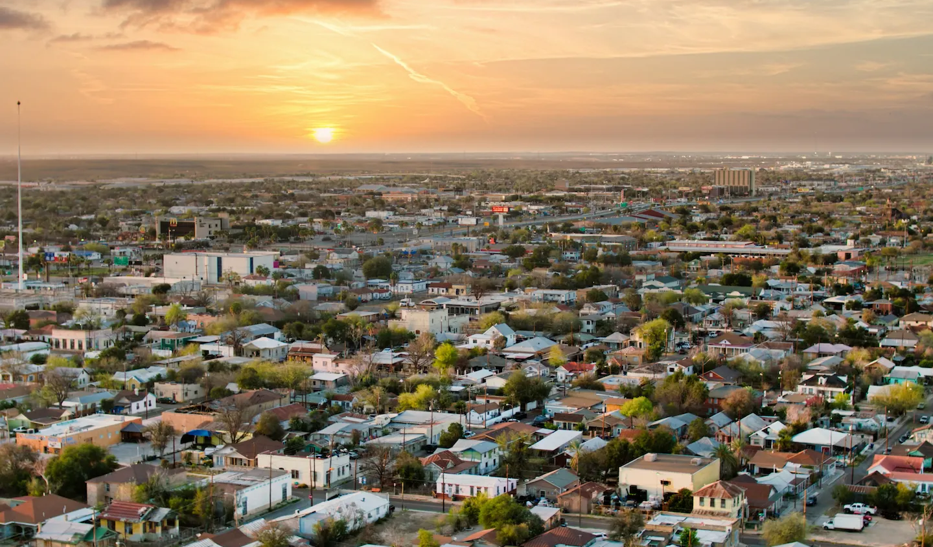

City of Laredo
Public Training Session
May 19, 2025
How to use AVOLVE Software to submit construction plans online
Presented by
Building Development Services Division

Slide 2
Overview
Application Submittal via Email
Flood Plain Application (if applicable)
AVOLVE Email Invitation (Open Project in AVOLVE)
AVOLVE Log in
Upload & Submit
Upload Plans Individually
Complete Task for “Upload & submit”
Corrections Required
Payment of Plan Review Fees
Plan Review
Respond & Resubmit
Final Payment
Approved/ Stamp Plans
Public Training Presentation
City of Laredo Building Development Services

Slide 3
Projects Reviewed via Avolve or Email
AVOLVE Software Projects
Email Projects
New Constructions
Tenant Improvements (finish out or Vanilla Box)
Additions
Change of Use
Alterations 1, 2 & 3
Parking Lots
Major repairs
Racking (mercantile or storage)
Signs
Demo
Foundation Only (email approval)
Minor Repairs
Cell Towers
Irrigations
Block Fence
Installation
Re-roofs
Public Training Presentation
City of Laredo Building Development Services

Slide 4
Application Submittal via Email
Fill out the application.
You may access the permit application, general requirements document, Avolve Guide, and the link to Avolve at the link below:
https://www.cityoflaredo.com/departments/building-development-services/permit-applications-requirements
Submit Building Permit Application via email to
COM bldgcomm@ci.laredo.tx.us
RESI bldgpermits@ci.laredo.tx.us
The application must be filled out completely. If a section does not apply, write N/A
Public Training Presentation
City of Laredo Building Development Services

Slide 5
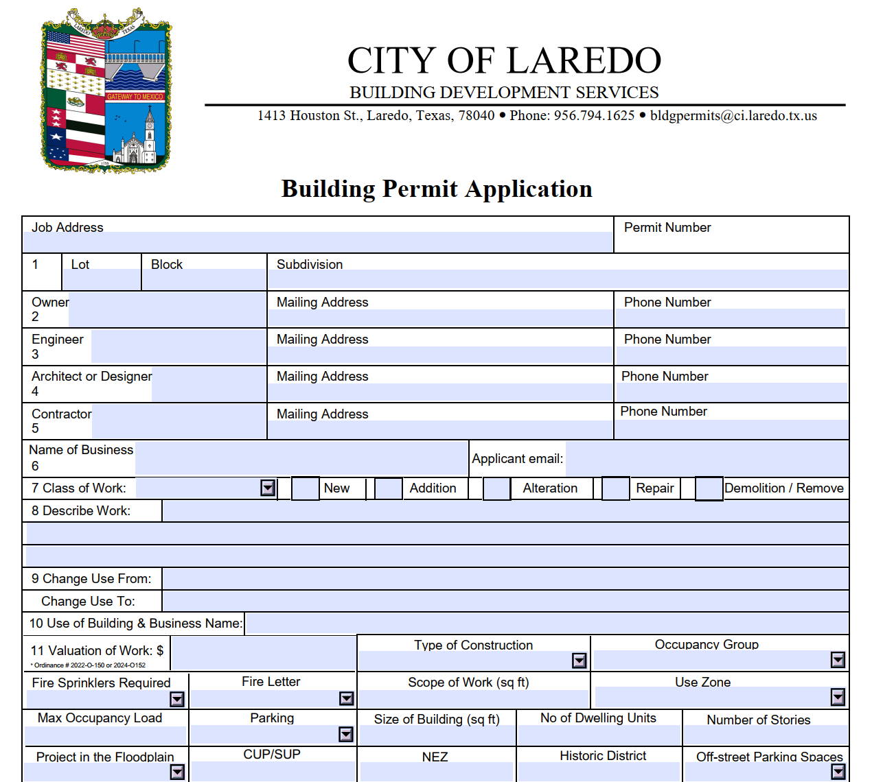
Public Training Presentation
City of Laredo Building Development Services

Slide 6
Application Submittal via Email
The location of the project is verified on GIS (correct address and if it’s in the floodplain)
Once the application is deemed complete and the location is not in the flood zone, the project is created on AVOLE
The applicant will receive an email notifying them that the project has been opened on Avolve.
Applicant will be communicating via AVOLVE with the Coordinator through this process.
Public Training Presentation
City of Laredo Building Development Services

Slide 7
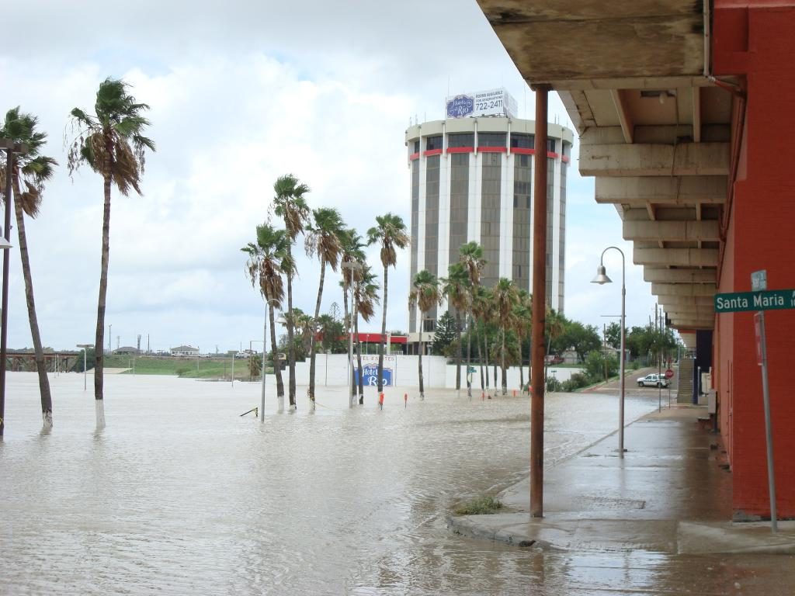
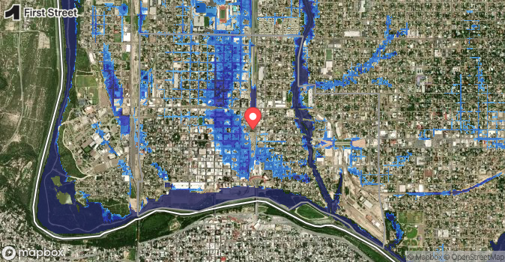
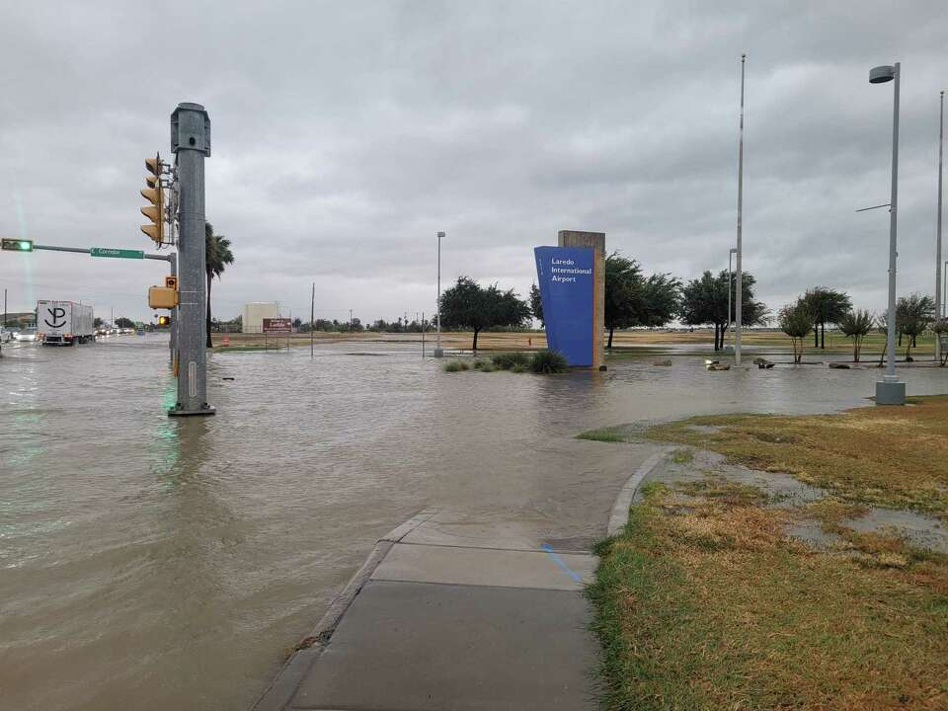
Floodplain Application
If the property is in a floodplain/flood zone, the applicant must first apply for a Flood Plain permit with the GIS Division.
(The applicant will be notified before proceeding)
Allow one business day for application review.
(Review time may vary based on the scope of work & submittal of a complete application)
Public Training Presentation
City of Laredo Building Development Services

Slide 8
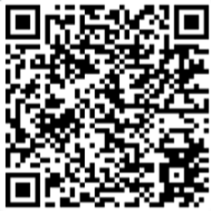
Floodplain Application Cont.
A Floodplain Development Permit will be required if a property is located within a floodplain/flood zone.
How to apply
Submit Floodplain application to Miguel Hernandez, GIS Analyst via email mhernande2@ci.laredo.tx.us
Applicant is notified by email of permit approval and required payment of $200 permit fee.
Plan review will not move forward until the floodplain permit is issued.
Public Training Presentation
City of Laredo Building Development Services

Slide 9
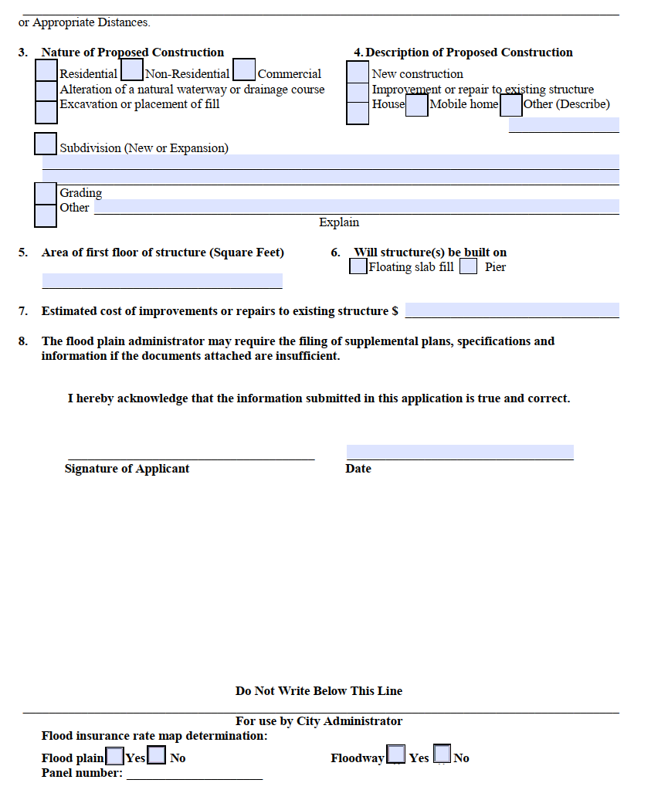
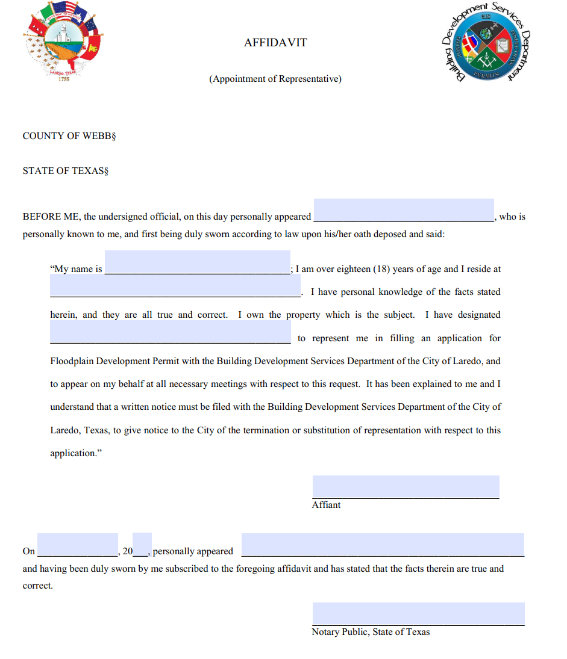
Public Training Presentation
City of Laredo Building Development Services

Slide 10
AVOLVE Email Invitation
An email notification with a link to the login page will be sent to the address provided on the building permit application.
If it is your first time logging into ProjectDox, the email will provide a temporary password.
The project coordinator will be the single contact who receives updates via ProjectDox.
Public Training Presentation
City of Laredo Building Development Services

Slide 11
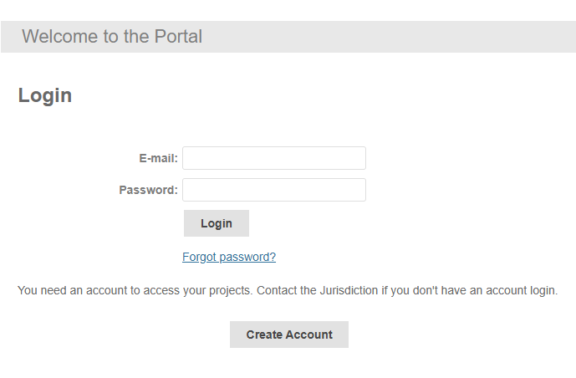
Public Training Presentation
City of Laredo Building Development Services

Slide 12
AVOLVE Log in
If you received a temporary password, you must change it to a permanent one and enter a security question and answer.
If you are having trouble signing in, click on forgot password to reset it. A code will be sent to your email.
The new password must be eight characters long, with no special characters. Only numbers and letters. Ex: H0uston1
Public Training Presentation
City of Laredo Building Development Services

Slide 13
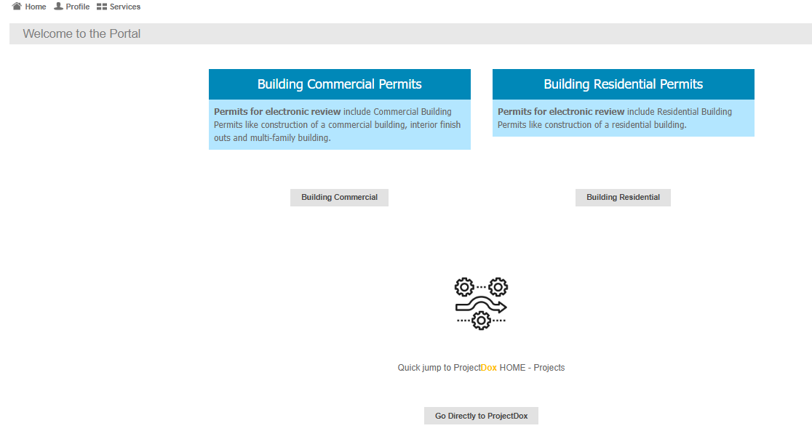
Click Here
Public Training Presentation
City of Laredo Building Development Services

Slide 14
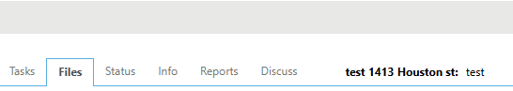
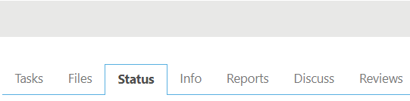
Comments from prescreen, Plan reviewers and customers
Permanent record
Notification that something is pending
Corrections require comments that require acknowledgement before project is completed
Details on the project progress
Location where files exist
Details of the project
Details of comments posted while project on review
Name of the project
Public Training Presentation
City of Laredo Building Development Services

Slide 15
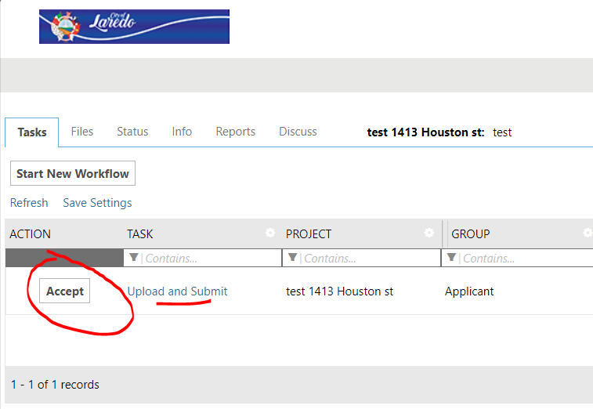
Upload & Submit
An email will be sent with instructions for the “Upload and Submit” task. To accept the task, click on the link ‘Upload and Submit’ on the Home Page Tasks tab to open the e-form.
Public Training Presentation
City of Laredo Building Development Services

Slide 16
Uploading Plans Individually
When creating the file name
It is recommended not to have more than 25 characters.
Ensure none of your file names are more than 70 characters, since that is the limit.
Do not include the street address in the file name, only include the plan sheet number and plan sheet name, example A1.0 FIRST FLOOR PLAN R
Refer to the table on next slide
Plan sheets are required to be UPLOADED INDIVIDUALLY.
Public Training Presentation
City of Laredo Building Development Services

Slide 17
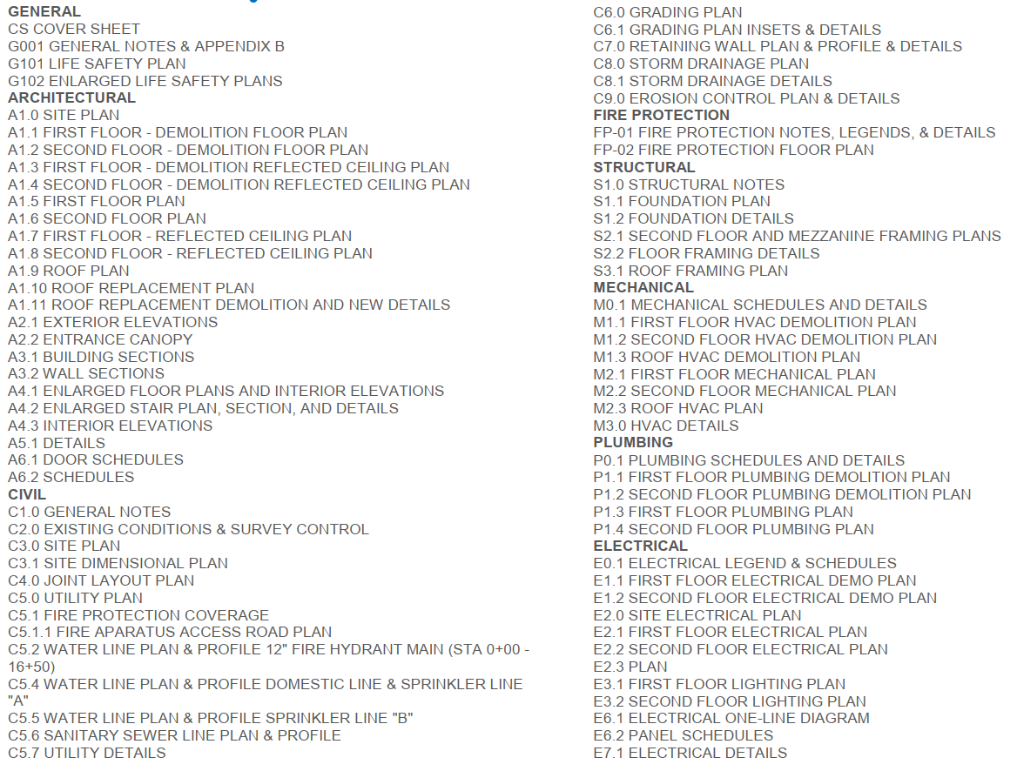
Public Training Presentation
City of Laredo Building Development Services

Slide 18
Upload Plans Individually Cont.
Title block: All pages shall include the name of the business and project address (legal and physical address).
Reserve an area for the plan sheet number.
Reserve an area for the date and revisions dates.
The plans must be to scale with a minimum output dimension of 24” x 36”
Place a cloud and the revision description & date in wording on the plans to quickly identify a markup and associate the comments (when applicable)
Plans shall comply with the City of Laredo Building Codes:
https://www.cityoflaredo.com/departments/building-development-services
Public Training Presentation
City of Laredo Building Development Services

Slide 19
Upload Plans Individually Cont.
Title Page
Index referencing Building Codes 2021 2024-O-148, 2024- O-149, 2024-O-150, 2024-O-151, and 2024-O-152
AMEPS-plans
Architectural, Mechanical, Electrical, Plumbing, Structural
Public Training Presentation
City of Laredo Building Development Services

Slide 20
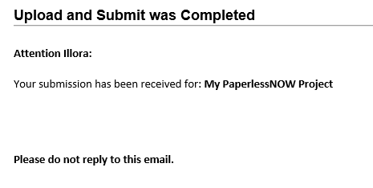
Complete task for “Upload & Submit”
You will receive an email confirmation that your upload has been received.
Once reviewed, you will be notified if corrections are required or if it is ready to be assigned for plan review.
This task can be repeated as many times as required until all corrections have been submitted. You will receive an email when your Prescreen review is accepted and review is beginning.
Public Training Presentation
City of Laredo Building Development Services

Slide 21
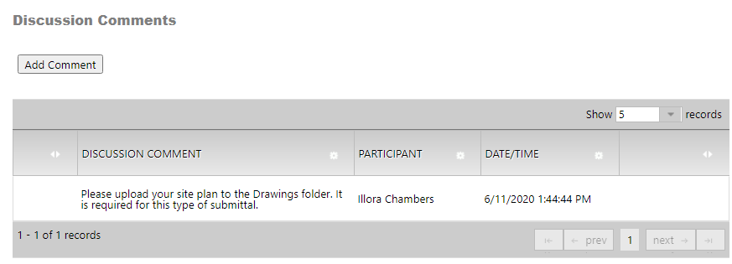

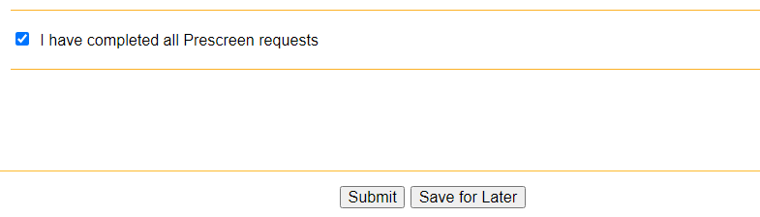
Mark the task complete and submit your corrections.
Public Training Presentation
City of Laredo Building Development Services

Slide 22
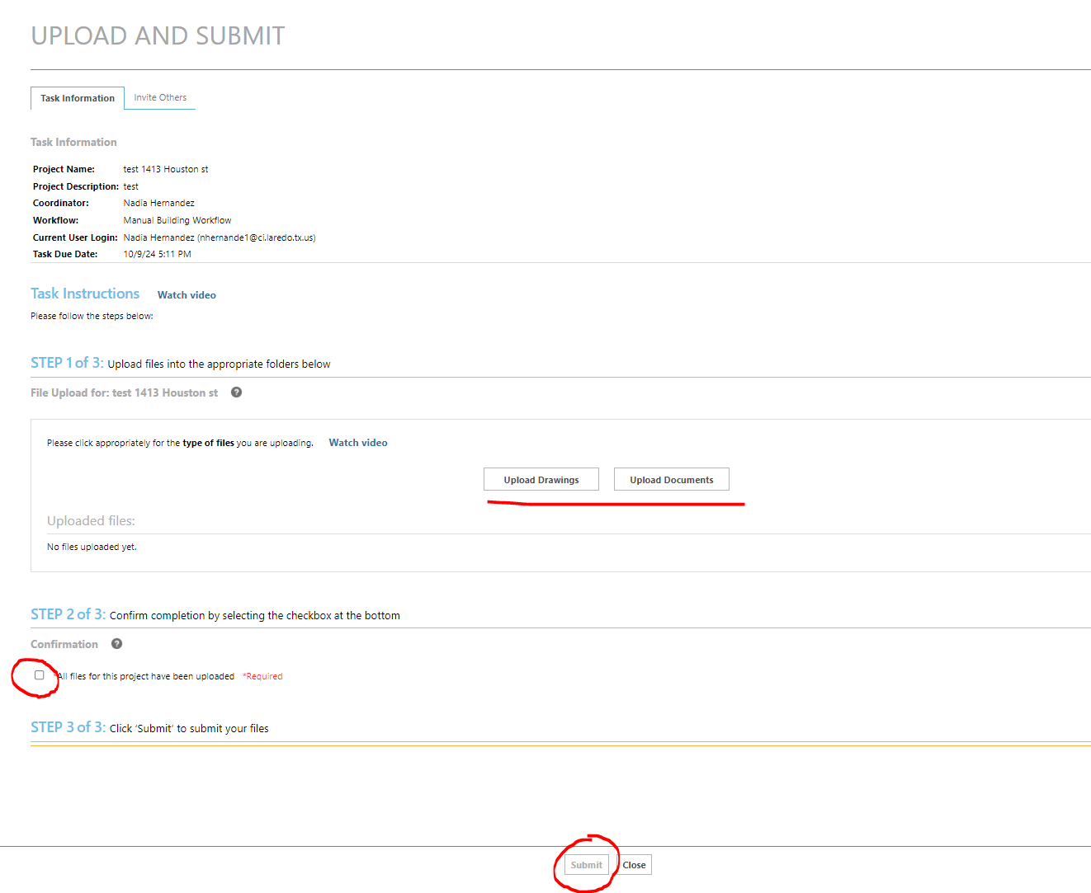





Public Training Presentation
City of Laredo Building Development Services

Slide 23
Corrections Required
If corrections are required, you will receive an email notification for a task “Prescreen Corrections”.
Login to ProjectDox and accept the task.
The Coordinator will enter comments with instructions.
After making your corrections, please add and save your comments in response to the Coordinator.
You are now ready to make your payment. The payment fees will be provided on the ‘Prescreen Corrections’ task.
Public Training Presentation
City of Laredo Building Development Services

Slide 24
Payment for Plan Review Fees
You will be provided the permit number and the plan review fee total in the comment section.
You can pay online through our Click2Gov portal at: https://lare-egov.aspgov.com/Click2GovBP/index.html
After the payment is made, send an email to: bldgcomm@ci.laredo.tx.us for Commercial projects or bldgpermits@ci.laredo.tx.us for Residential projects with confirmation of payment and include the permit number.
Be sure to send back the task on Avolve once payment is completed.
Public Training Presentation
City of Laredo Building Development Services

Slide 25
Plan Review
After the prescreen process is completed, the project will be scheduled for plan review, and the appropriate divisions will be assigned.
Public Training Presentation
City of Laredo Building Development Services

Slide 26
Respond & Resubmit
Once all the divisions have completed their review and if corrections are required, you will receive an email with instructions for your task ‘Respond and Resubmit’.
Accept the task to open the e-form.
Public Training Presentation
City of Laredo Building Development Services

Slide 27
Respond & Resubmit Cont’d
When resubmitting, use the SAME original file name to create a new version of the file (check caps, spaces, etc.). It is required by ProjectDox to keep track of the revised plans in the Drawings and Documents folders.
The Approved folder is ONLY for the final approved drawings and folders
DO NOT UPLOAD anything in the ‘Approved’ folder.
Public Training Presentation
City of Laredo Building Development Services

Slide 28
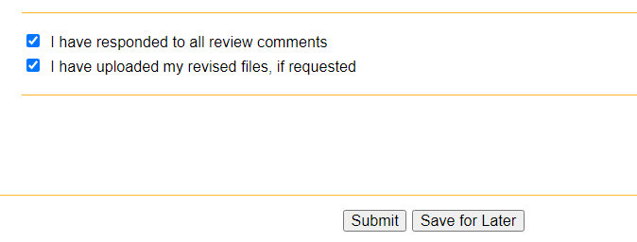
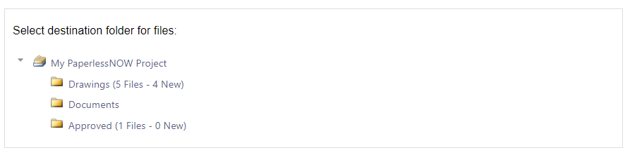
Mark the task complete and submit
If there are corrections needed in your resubmittal, you will receive an email and task from the Coordinator with actions needed before the subsequent review can begin.
Public Training Presentation
City of Laredo Building Development Services

Slide 29
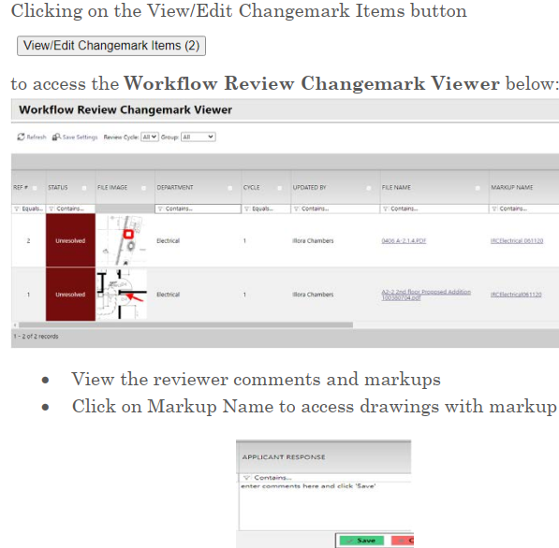
Public Training Presentation
City of Laredo Building Development Services

Slide 30
Respond & Resubmit
There are several sections on the e-form as described below:
View the reviewer comments and markups
Click on Markup Name to access drawings with markup
You have the option to respond to the reviewer comments by entering your comments in the “Applicant Response” column on the change mark viewer beside each markup.
You can organize/sort columns and save settings for your personal view
Public Training Presentation
City of Laredo Building Development Services

Slide 31
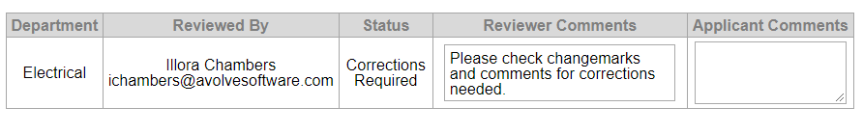
Respond & Resubmit Cont’d
Review Status and review Comments; Click on the tab Review and the comments will appear.
Click on Markup Name to access drawings with markup
You have the option to respond to the reviewer comments by entering your comments in the “Applicant Response” column on the change mark viewer beside each markup.
You can organize/sort columns and save settings for your personal view
Public Training Presentation
City of Laredo Building Development Services

Slide 32
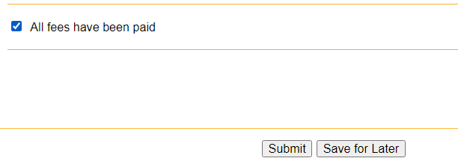
Final Payment
When all the reviewers have completed and approved the project, the Coordinator will verify if final payment is due before stamping the plans.
Follow the same instructions used for the initial payment.
You will receive an email notification and a task for any additional fees due. It will be your responsibility to pay all the final fees.
Mark the task complete and submit
Public Training Presentation
City of Laredo Building Development Services

Slide 33
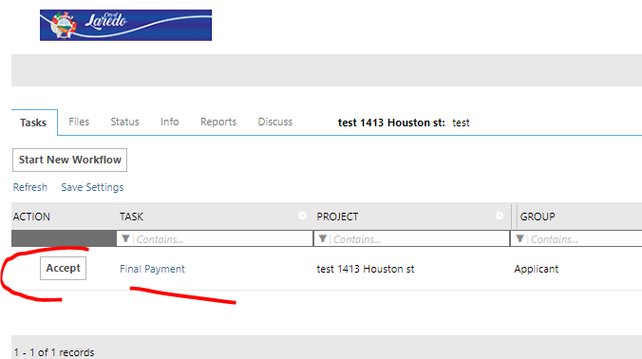
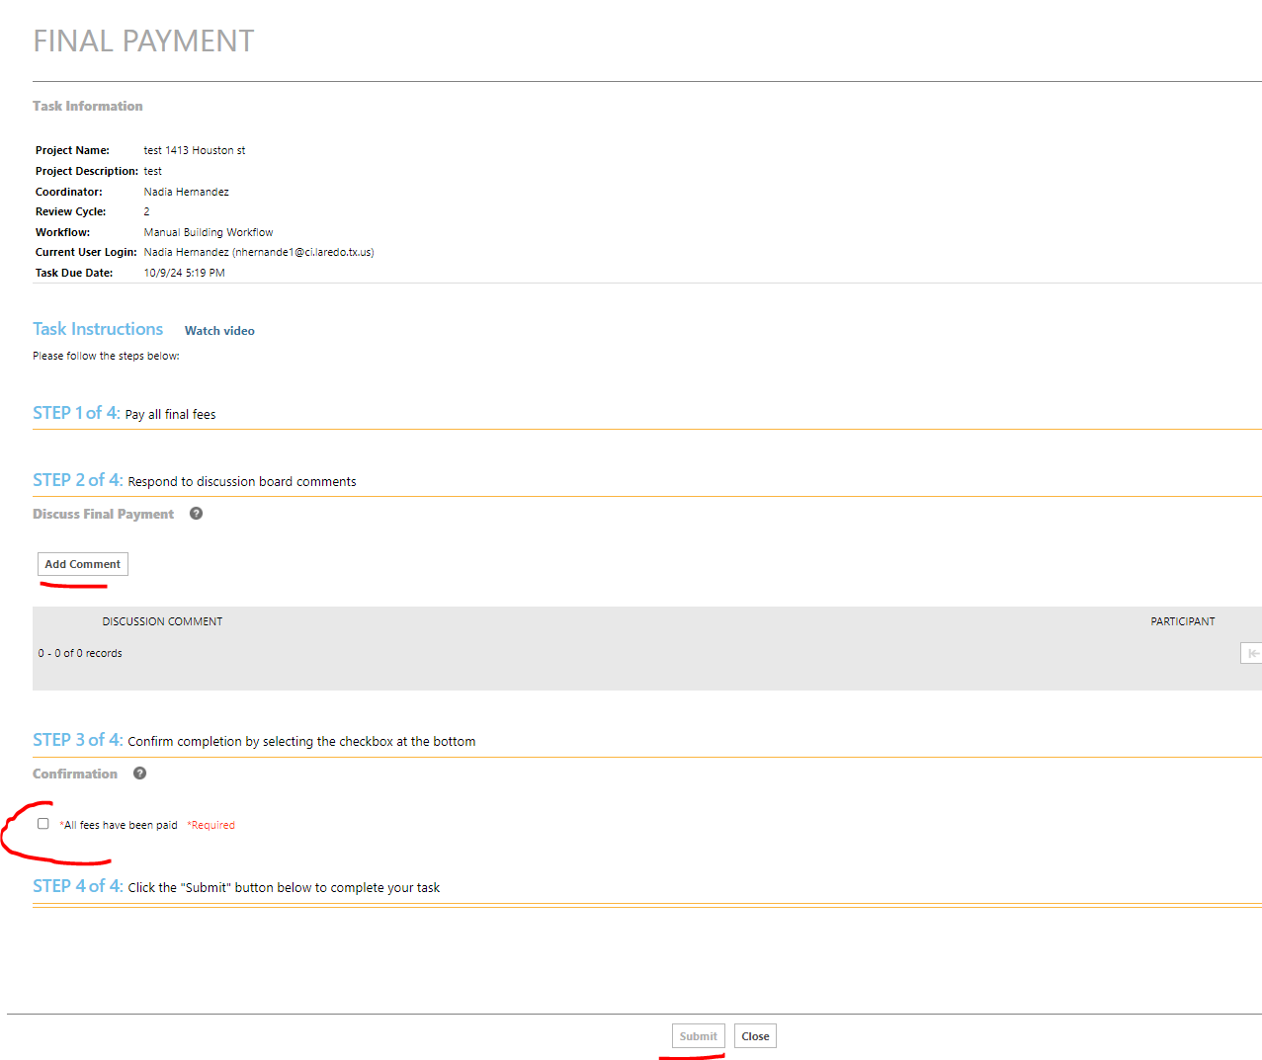
Public Training Presentation
City of Laredo Building Development Services

Slide 34
Approved/Stamped Plans
You will receive an email notification that your plans are available for download.
The plans can be found in the ‘Approved’ folder. Please confirm if you have access to this folder.
The approved/stamped plans are required to be on site for inspections.
Please do not wait for the day the fire inspection is scheduled to ask for these plans.
Public Training Presentation
City of Laredo Building Development Services

Slide 35
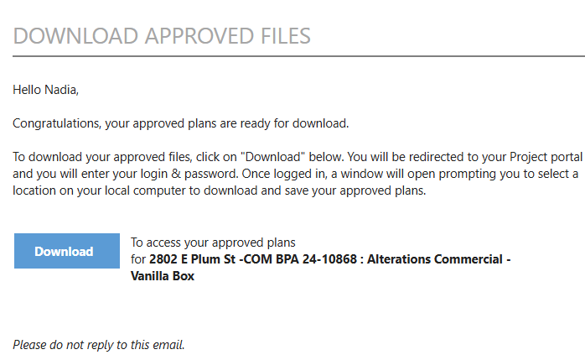
Public Training Presentation
City of Laredo Building Development Services

Slide 36
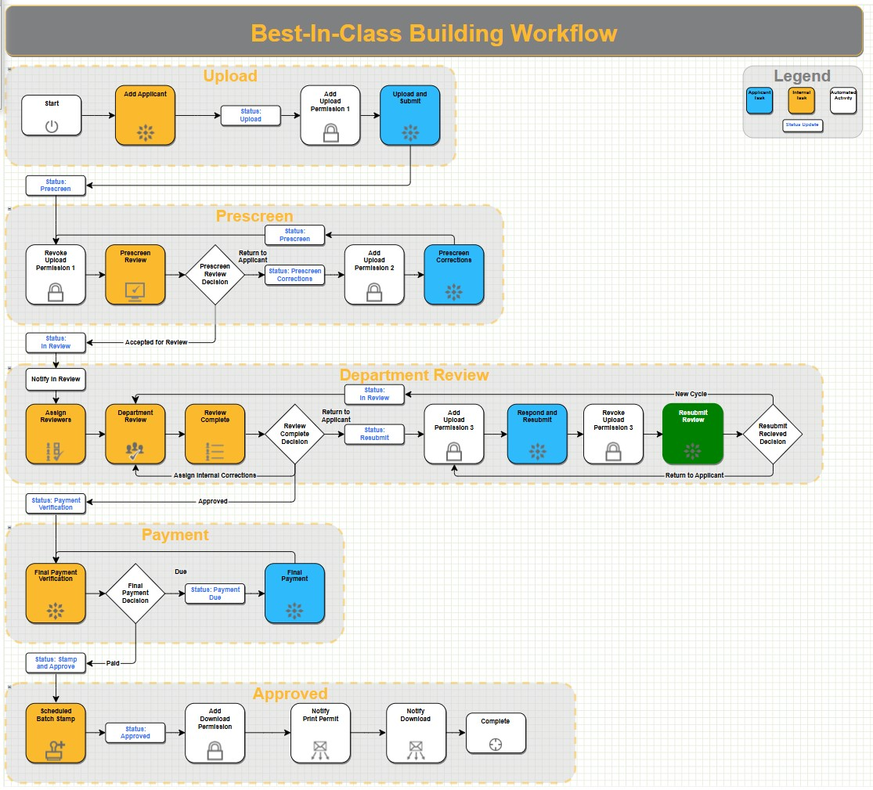
Workflow Chart
Public Training Presentation
City of Laredo Building Development Services

Slide 37
Plan Reviewers
Commercial Division
(956) 794-1625 Option # 3 bldgcomm@ci.laredo.tx.us
Monica Ashley Montes Liliana Silva-Hinojosa Armida Vasquez Mario Santos IV Antonio Vilchis
Prescreen:
Mercedes Camacho
Residential Division
(956) 794-1625 Option # 2 bldgresi@ci.laredo.tx.us
Miriam Villarreal
Prescreen:
Sonia Marquez
Public Training Presentation
City of Laredo Building Development Services

Slide 38
Avolve Training
Training is available Monday through Friday from 9:00 am to 3:00 pm
Email or call us to schedule a training.
Individual or group training sessions are available
Public Training Presentation
City of Laredo Building Development Services

Slide 39

Questions?
Public Training Presentation
City of Laredo Building Development Services

Slide 40
Thank you!
Contact Information:
Address: 1413 Houston St., Laredo, TX
Hours: 8:00 A.M. – 5:00 P.M.
Monday to Friday
Phone: (956)794-1625
Public Training Presentation
City of Laredo Building Development Services

