Slide 1


TOWN HALL MEETING
TOPICS OF DISCUSSION
NEW PERMIT AND SERVICES FEES EFFECTIVE DECEMBER 28, 2024
INSURANCE REQUIREMENTS FOR RIGHT-OF-WAY UTILITY CONTRACTORS
AMENDMENT TO RIGHT-OF-WAY ORDINANCE
Laredo City Planning Department

Slide 2
BACKGROUND
On August 10, 2023, during the Budget Workshop meeting, the City Council directed the Building Department to establish permit fees
Permit Fees were last amended on September 17, 2012 thru Ordinance No. 2012-O-150

Slide 3
NEW PERMIT & SERVICE FEES EFFECTIVE DECEMBER 28, 2024
FEES | CURRENT | PROPOSED | VARIANCE
Foundation Only Permit | -0- | $200.00 | $200.00
Solar Panel Permit | -0- | $200.00 | $200.00
Pre-Development Service | -0- | $200.00 | $200.00
After-hour Inspection Service | $50.00 | $150.00 | $100.00
Partial Inspection Service | -0- | $75.00 | $75.00

Slide 4
FOUNDATION-ONLY PERMIT FEE
A foundation-only permit is allowed by International Building Council (IBC) 107.3.3 Phased approval. The building official is authorized to issue a permit for the construction of foundations or any other part of a building or structure before the construction documents for the whole building or structure have been submitted, provided that adequate information and detailed statements have been filed complying with pertinent requirements of this code. The holder of such permit for the foundation or other parts of a building or structure shall proceed at the holder’s own risk with the building operation and without assurance that a permit for the entire structure will be granted.
The Building Department has been granting foundation-only permits for a couple of years. This process has created an additional burden on office staff to process, inspect, and document the status of phased permits
The Building Department has requested to establish a foundation-only permit process and a permit fee for contractors voluntarily applying. (This permit is not mandatory)

Slide 5
SOLAR PANEL PERMIT FEE
Solar Panel Permit is required as per Chapter 15, Roof Assemblies and Rooftop Structures section 1505.8 Building-integrated photovoltaic products, Chapter 16, STRUCTURAL DESIGN AND Chapter 31, SOLAR ENERGY SYSTEMS
The International Building Council (IBC) requires a permit and inspection of the solar panels.
The Building Development Services has been granting electrical permits for solar panels without inspecting the rooftops, the underlayment, or the ballasted system.

Slide 6
PRE-DEVELOPMENT MEETING SERVICE FEE
The Building Development Services has been granting meetings with developers for years.
This process has created an additional burden on office staff to answer questions and provide specific feedback to proposed development.
The Building Development Services can provide feedback to developers by phone or email. However if the developers want one-on-one (in-person or WebEx) meetings, Building Development Services recommends to establish a process and a fee. (This meeting is not mandatory)

Slide 7
AFTER-HOUR INSPECTION SERVICE FEE
After-hour inspections for building, mechanical, electrical, plumbing, and right-of-way fees to be standardized as the same amount of $150.00 per inspection.
The Building Development Services recommends the approval standardizations of the After-hour Inspection fee to increase from $50.00 to $150.00 per inspection.
Due to the current cost of living, labor, and transportation has created an additional cost increase. In order to cover the after-hour inspections cost increase, we recommend approval of proposed fee increase.

Slide 8
PARTIAL INSPECTION SERVICE FEES
Partial Inspections have been granted for years on electrical, plumbing, mechanical, or building issues
This process has created an additional burden on office staff to partially facilitate inspections and provide specific feedback to proposed projects
The Building Development Services recommends the creation and approval standardizations of a Partial Inspection fee per inspection of $75.00

Slide 9
Amending City of Laredo,
Code of Ordinances
Chapter 7 Building & Mechanical permit fees
Chapter 11 Electrical permit fees
Solar panels
Chapter 25 Plumbing permit fees

Slide 10
Remove from City of Laredo, Land Development Code
Chapter 24, Appendix D, Permit Fees
Building Permit Fees
Moving Fee
Demolition Fee
Penalties
Plan Checking Fees
Plumbing Permit Fees
Mechanical Permit Fees
The Building Development Services recommends that all fees be in one location to effectively implement

Slide 11
COMPARISON TO OTHER CITIES

Slide 12
INSURANCE REQUIREMENTS FOR RIGHT-OF-WAY UTILITY CONTRACTORS
Certificate of Insurance:
Commercial Liability Insurance for $2,000,000
Commercial Automobile Liability for $1,000,000
Workers Comp for $1,000,000
Umbrella Liability $1,000,000 (required if project over $1,000,000)
The certificate holder must read the following:
City of Laredo
1413 Houston St
Laredo, TX 78040
As per City of Laredo Risk Management Dept, the COI requires an update for additional insured for the General Liability and Auto Liability and the waiver of subrogation for General Liability, Auto Liability and Workers Compensation.
City of Laredo
Insurance Provisions & Limits

Slide 13
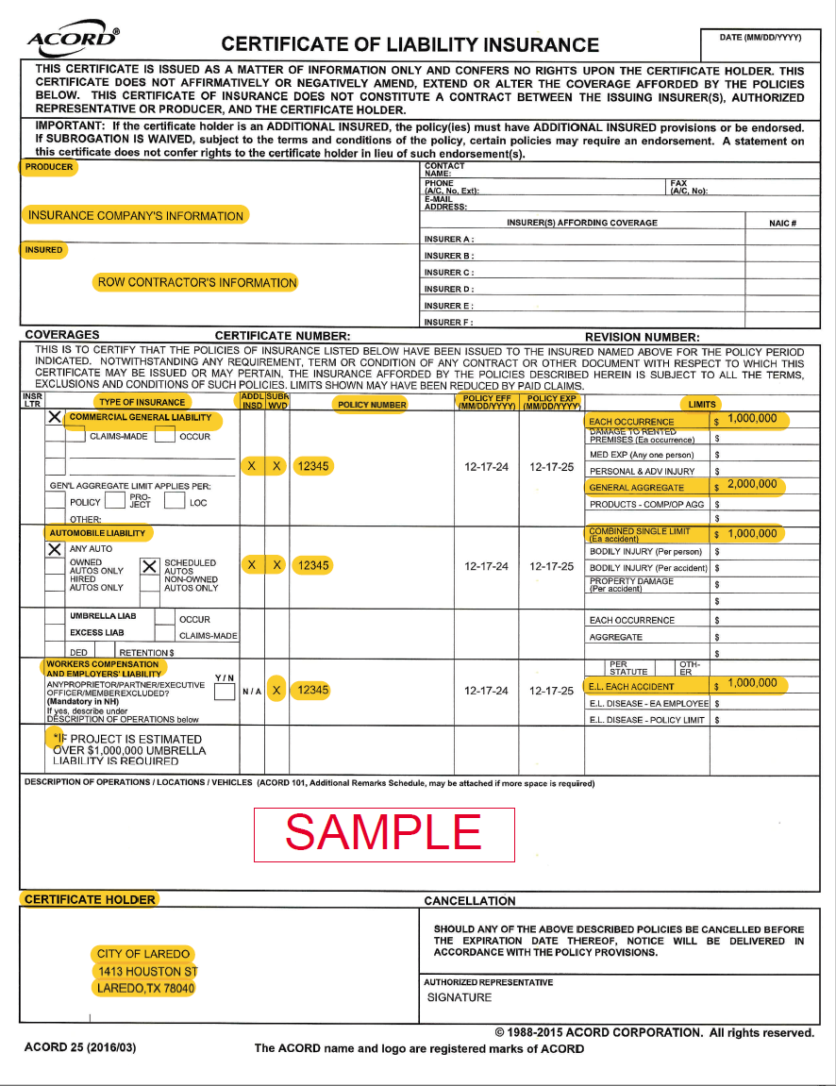
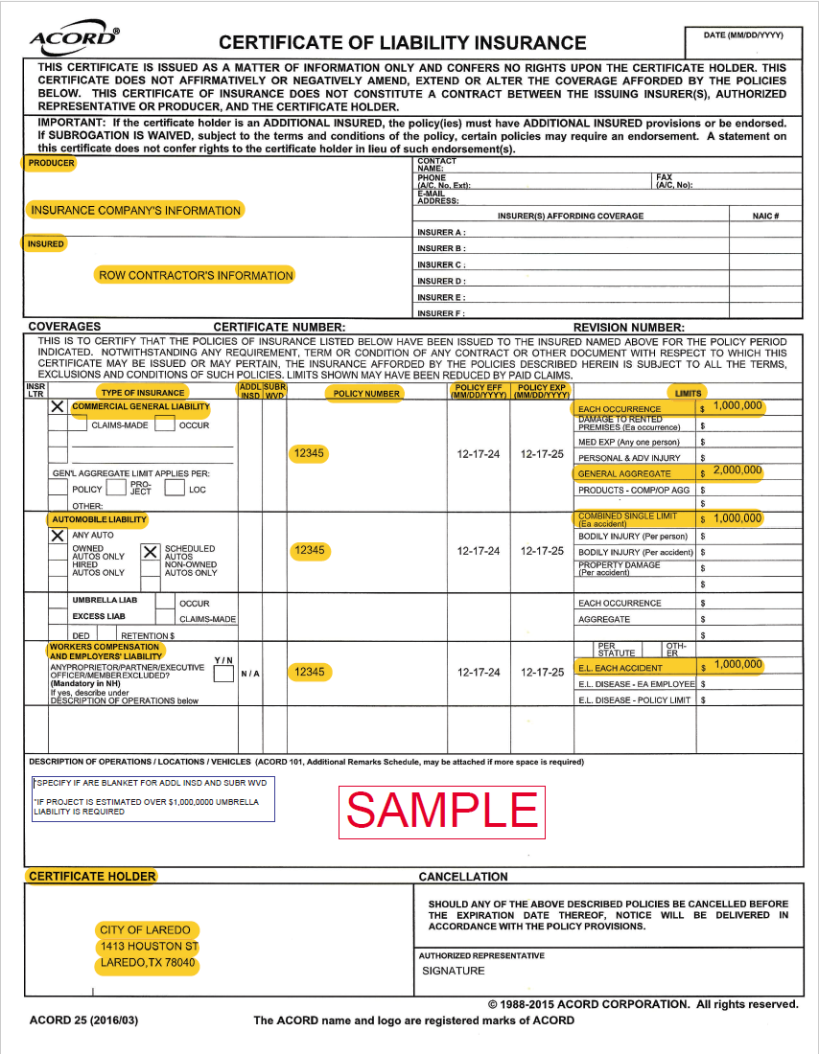
SAMPLE OF CERTIFICATE OF INSURANCE
Sample of COI
Blanket Coverage for addl insd & sbr wvd

Slide 14
UPCOMING
Amendment to Ordinance 2022-O-212
MANDATE HYDRO EXCAVATION
Pre-inspection
Expose existing utilities to approve alignment
2. Post-inspection
After construction started to verify align
3. Final inspection
Inspection of all repairs as per SPEC book.
The potential date to be added to the City Council agenda is
January 21, 2025

Slide 15


