Slide 1

TOWN HALL MEETING
SIGNIFICANT CHANGES TO
2021 ICC BUILDING & FIRE CODES
AND
2020 NATIONAL ELECTRICAL CODE of the National Fire Protection Association (NFPA)
Laredo City Planning Department

Slide 2
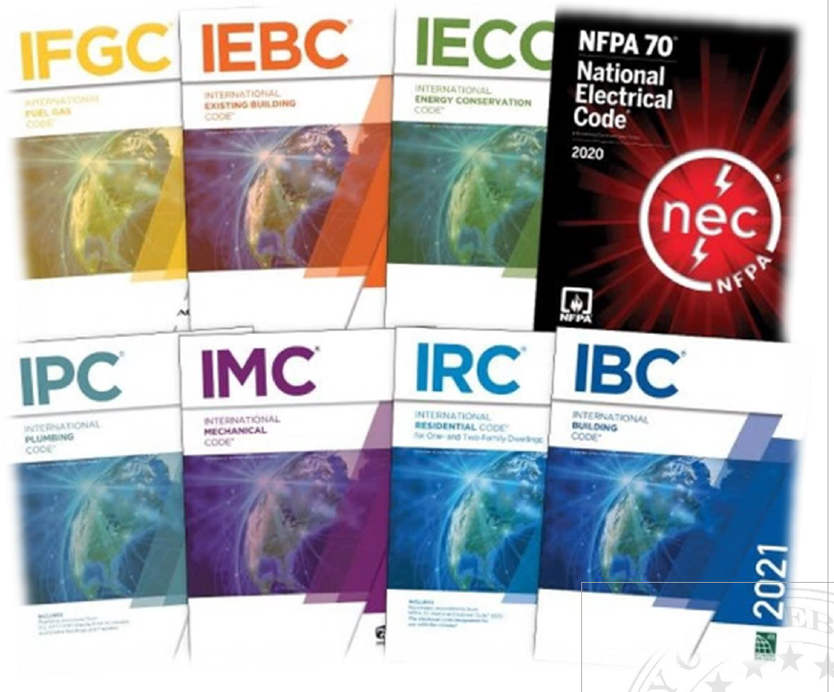
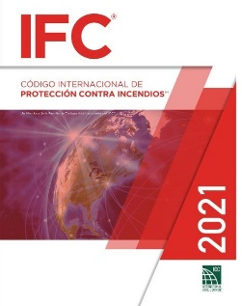
BACKGROUND
Updated every 3 years by the International Code Council (ICC)
Laredo last updated its building codes for the 2018 cycle
Apply to all new residential and non-residential construction in the City (not retroactive)
Ensures health, safety, and welfare and resource conservation
Laredo City Planning Department

Slide 3
2021 INTERNATIONAL BUILDING CODE
SIGNIFICANT CHANGES
202 - Definition: Change of occupancy
o Modification: Defines change of occupancy as a change in occupancy classification, purpose, or activity level, generally associated with an increase in safety, accessibility, fire protection, structural, egress, ventilation, or sanitation requirements.
202 - Definition: Puzzle room
o Addition: New definition to go with new regulations for escape rooms
202 - Definition: Special amusement area
o Addition: New definition to go with regulations for haunted houses and similar attractions where the path of travel may be deliberately unclear
306.2 - Group F-1 occupancy
o Addition: Water/sewer treatment facilities and buildings dedicated to energy storage systems have been added the list of F-1 occupancies.
307.1.1 - Uses not classified as Group H
o Modification: Distilling, brewing, and storing beer, wine, and spirits is not necessarily in Group H as long as it complies with the International Fire Code.
311.2 & 311.3 - Alcoholic beverage storage
o Clarification: Beverages over 16% alcohol are in the S-1 moderate-hazard storage group; beverages at or below 16% are in the S-2 low-hazard storage group.
IBC 1 of 8

Slide 4
2021 INTERNATIONAL BUILDING CODE
SIGNIFICANT CHANGES
406.6.4 - Mechanical access parking garage
o Addition: New section covers enclosed parking garages where cars are parked by machinery.
• 422.7 - Domestic cooking in ambulatory care facilities
o Addition: New rules for domestic cooking appliances in care facilities include fire safety measures, gas shutoffs with supervisory staff access, and timed shutoffs for appliances.
• 424 - Play structures
o Modification: This section was formally known as children’s play structures. The code dropped the “children’s” part because this section applies to recreational equipment used by adults as well, such as climbing walls and obstacle courses. A section was also added to address flame spread limitations on interior finishes for play structures.
• 503.1 - Height/area limitations
o Amendment: Clarified that fire walls are required between different types of construction
506.3.2 - Allowable areas
o Addition: Simplified calculations for increases based on open yards
IBC 2 of 8

Slide 5
2021 INTERNATIONAL BUILDING CODE
SIGNIFICANT CHANGES
Table 508.4 - Required separation of occupancies
o Clarification: Required separation in hourly rating is simplified in this table
• 508.4.4.1 - Separated occupancies
o Addition: Requires thermal barrier between mass timber and the building interior in new Types IV-B and IV-C construction types
• 509.4.1.1 - Incidental areas
o Addition: Requires thermal barrier between mass timber and the building interior in new Types IV-B and IV-C construction types
• 603.1 - Combustible materials in Types I & II construction
o Modification: Fire retardant treated wood may be allowed in walls rated 2 hours or less, except in shaft enclosures for I-2 and ambulatory care facilities. It is allowed in I-2 roof construction with Class A roof covering.
• 602.4/Table 601 - Mass timber
o Addition: 3 new construction types: IV-A, IV-B & IV-C for mass/heavy timber construction.
Chapter 7 - Fire resistance
o Various amendments and new sections added to coincide with new mass timber construction types.
IBC 3 of 8

Slide 6
2021 INTERNATIONAL BUILDING CODE
SIGNIFICANT CHANGES
704.6.1 - Structural fire Protection
o Modification: Now requires any attachments to fire rated steel members to be rated for at least 12" away from structural member.
716.4 - Fire Curtains
o Addition: New listing and labeling requirements for fire curtains. Fire curtains are not specifically required or allowed by the code, but if they are used by special approval or trade-off, standards are now provided.
• Table - 716.1(2)
o Modification: Added requirements for back-to-back doors in Double Fire Walls
• 717.2 - Static fire dampers
o Modification: Static fire dampers & ceiling dampers are now allowed if HVAC has automatic shut down during fires.
• 718.3 & .4 - Draftstopping
o Amendment: Sprinklers required in floor cavities and attics in order to meet exception to eliminate draft stops
• 806.9 - Combustible lockers
o Addition: Lockers that are wooden, plastic, etc. now have to meet the same interior finish rating as for walls & ceilings.
IBC 4 of 8

Slide 7
2021 INTERNATIONAL BUILDING CODE
SIGNIFICANT CHANGES
• 1006.3.4 - Singe exit from stories
o Modification: Instead of using Common Path of Travel, total travel to an exit is now used to determine when 2 exits are required from a story. Total travel is still limited to 75'-100' for most occupancies.
• 1008.2.1 - Egress illumination
o Modification: Increases amount of lighting for along stairs & landings from 1 foot-candle to 10 f-c while stairs are in use (occupant sensors)
1009.2.1 - Accessible egress
o Modification: Now requires elevator to occupied roofs if 4 stories or more
• 1009.6.3 - Areas of refuge
o Modification: Increased size of areas of refuge from 30"x40" to 30"x 52"
• 1010.1.1 - Max. door width
o Modification: Door width no longer limited to 4 ft. max. (if all other requirements met)
IBC 5 of 8

Slide 8
2021 INTERNATIONAL BUILDING CODE
SIGNIFICANT CHANGES
1105.1.1 - Accessible entrances
o Addition: Now requires automatic doors at public entrances for larger buildings in A, B, M, R-1 uses with occupant load exceeding 300
• 1107.2 - Vehicle charging stations
o Addition: Now requires 5% of charging spaces to be van accessible parking spaces
• 1202.3 - Unvented attics
o Modification: Expands alternatives for unvented attic spaces if air permeable insulation and 'vapor diffusion ports' (new definition) are used
• 1207 - Classroom acoustics
o Addition: Now requires Group E classrooms to comply with acoustics standards in ICC/ANSI A117.1-2017
• 1210.3 - Restroom privacy
o Addition: New requirement to provide privacy screening at entrance to public restrooms designed for more than one occupant
• Chapter 29 - Various sections
o Additional methods added to determine number and distribution of toilet and bathing facilities
IBC 6 of 8

Slide 9
2021 INTERNATIONAL BUILDING CODE
SIGNIFICANT CHANGES
• 3005.4 - Elevator machine rooms
o Amendment: Revises exceptions for machine room enclosures. All machine rooms will be required to be rated, except if in an atrium or parking garage.
• 3103.1 - Special event structure
o Clarification: Temp structures now include Special Event Structures (outdoor stages, etc.)
• 3111.2 – Solar Thermal Systems
o Addition: Where light-transmitting plastic covers are used, solar thermal collectors shall be designed in accordance with Section 2606.12.
• 3114 - Public restrooms in flood hazard areas
o Addition: New requirements for public restrooms on public land (parks, etc.) that are in flood hazard areas
• 3115 - Shipping containers
o Addition: IBC now recognizes shipping containers as buildings if they comply with certain standards, shipping containers are valid for safe construction
Note: The Land Development Code Book does not allow shipping containers
• 3313 - Fire protection
o Modification: Expands requirements to
IBC 7 of 8

Slide 10
2021 INTERNATIONAL BUILDING CODE
SIGNIFICANT CHANGES
SECTION 1404
INSTALLATION OF WALL COVERINGS
TABLE 1404.2
MINIMUM THICKNESS OF WEATHER COVERINGS
Adhered masonry veneer Architectural cast stone Other | 0.25 0.75 0.25
Architectural cast stone | 1.25 2.5
Porcelain tile | 0.25 0.125 nominal
IBC 8 of 8

Slide 11
2021 INTERNATIONAL RESIDENTIAL CODE
SIGNIFICANT CHANGES
R301.1.4 -added section for Intermodal shipping containers that are repurposed for use as building or structure needing to be designed based on structural provisions of section 3115 of the International Building Code.
R301.2 -wind design will now be required to follow design guidelines in the ASCE 7 -16
R302.5 -Added language to clarify that the door between house and garage also needs to be self-latching.
R303.1 -Now requires local exhaust for kitchens that do not have openable outside windows in the kitchen area.
R305.1 –The minimum ceiling height is reduced to 6 feet 6 inches under beams spaced apart at least 36 inches apart
R308.4.5 -Added language to clarify that any glazing under 60” high and within 60” horizontally from shower or bath will need to be safety glazing.
R310.1 -added language to require a 36” minimum width open path that leads to a public right-of-way outside of emergency escape and rescue openings
IRC 1 of 4

Slide 12
2021 INTERNATIONAL RESIDENTIAL CODE
SIGNIFICANT CHANGES
R310.2 -modified language to require the maximum height of the bottom of the opening of the emergency escape and rescue window to be no higher than 44’ above floor instead of measuring to the sill.
R310.4,310.5, and 310.6 -modifications to required size of emergency escape and rescue openings in existing alterations
R311.7.7 -we will propose an amendment to add language that the stair landing at grade needs to be solid and stable.
R312.2 -modified language to measure the maximum height of the bottom of the opening for Window Fall protection to the bottom of the window opening instead of sill.
R314.3 -added requirement for location of smoke alarms where there is change of elevation in ceiling heights of 24” or more outside bedrooms
R326 - the section for Habitable Attics has been modified and expanded.
R314.3.1 -Smoke alarm near cooking appliances now include:
1. Smoke alarms listed and marked “helps reduce cooking nuisance alarms” shall not be installed less than 6 feet horizontally from permanently installed cooking appliance.
IRC 2 of 4

Slide 13
2021 INTERNATIONAL RESIDENTIAL CODE
SIGNIFICANT CHANGES
• R403.1(1) -Table R403.1(1) Minimum Width and Thickness for Concrete Footings for Light-Frame Construction is revised to more accurately reflect current practice.
R506.2.3 -Thicker vapor retarders are now required below slabs-on-grade.
R507 –Deck beams and joist new spans lengths. Specific specie length requirements for posts. Decking span requirement changes.
• R602.9 -Cripple walls requirements apply only to exterior cripple walls.
• R609.4.1-All garage doors must have a permanent label identifying wind pressure ratings among other information.
• R703.2 and 703.7.3 -Language for water-resistive barriers is clarified with wet or dry climates specifically considered.
• R704 –Requirements for soffit material and installation are expanded.
IRC 3 of 4

Slide 14
2021 INTERNATIONAL RESIDENTIAL CODE
SIGNIFICANT CHANGES
Appendix AQ relaxes various requirements in the body of the code as they apply to houses that are 400 square feet in area or less. Attention is specifically paid to features such as compact stairs, including stair handrails and headroom, ladders, reduced ceiling heights in lofts and guard and emergency escape and rescue opening requirements at lofts
Note: Pending to clarify the Land Development Code lot density and zone use. We currently treat them as regular single family residence.
IRC 4 of 4

Slide 15
2021 INTERNATIONAL PLUMBING CODE
SIGNIFICANT CHANGES
1. Handwashing Requirements:
• Separate Facilities: The 2021 IPC introduces a requirement that handwashing sinks must be located in or immediately adjacent to toilet rooms in public facilities. This ensures better accessibility and promotes hygiene.
2. Water Supply and Distribution:
• Plastic Piping: The code has updated provisions regarding the use of plastic piping materials, including specific references to standards and testing requirements for different types of plastic piping.
• Hot Water Temperature: The maximum allowable temperature for hot water delivery to fixtures intended for handwashing has been revised to 110°F (43°C) to prevent scalding.
3. Legionella Risk Management:
• The 2021 IPC includes guidelines aimed at reducing the risk of Legionella bacteria in building water systems. This includes provisions for the design, installation, and maintenance of hot water systems to prevent bacterial growth.
4. Drainage and Vent Systems:
• Single Stack Venting: The code has expanded the allowances for single-stack vent systems, providing more flexibility in design while ensuring proper venting and drainage.
• Island Fixture Venting: The revisions also clarify the requirements for venting of island fixtures, which are often challenging to vent traditionally.
IPC 1 of 2

Slide 16
2021 INTERNATIONAL PLUMBING CODE
SIGNIFICANT CHANGES
5. Storm Drainage:
• Sizing of Roof Drains: Updates have been made to the sizing methods for roof drains and storm drainage systems, particularly in relation to extreme weather events and the management of large volumes of water.
6. Water Efficiency:
• Fixture Flow Rates: The 2021 IPC further emphasizes water conservation by tightening the flow rate requirements for plumbing fixtures, aligning with modern sustainability practices.
7. Health and Safety Enhancements:
• Backflow Prevention: There are more stringent requirements for backflow prevention devices and assemblies to protect potable water supplies from contamination.
• Grease Interceptors: Revisions have been made to the design and installation standards for grease interceptors, especially in commercial kitchens.
8. Alternative Water Sources:
• Gray Water and Reclaimed Water: The code includes expanded provisions for the use of gray water and reclaimed water systems, reflecting growing interest in sustainable water management practices.
IPC 2 of 2

Slide 17
2021 INTERNATIONAL MECHANICAL CODE
SIGNIFICANT CHANGES
1. Ventilation Requirements:
• Updated ventilation rates based on new studies and standards.
• Enhanced requirements for ventilation in commercial kitchens, focusing on the design and operation of hoods and exhaust systems.
2. Refrigeration Systems:
• New safety measures for refrigerant use, including updates on refrigerants with low Global Warming Potential (GWP).
• Additional criteria for machinery rooms, ventilation, and emergency controls for refrigeration systems.
3. Combustion Air:
• Revised provisions for combustion air requirements, particularly in residential and commercial settings, ensuring proper air supply for fuel-burning appliances.
4. Duct Systems:
• Changes in duct system design and installation, including updated sealing requirements to reduce energy loss.
• New provisions for the installation of duct systems in areas prone to flooding.
5. Exhaust Systems:
• Modified requirements for bathroom exhaust systems, including fan sizing and installation specifications.
• Enhanced rules for the exhaust of hazardous materials in laboratory settings.
IMC 1 of 2

Slide 18
2021 INTERNATIONAL MECHANICAL CODE
SIGNIFICANT CHANGES
6. Heating and Cooling:
• Updates to the efficiency requirements for heating and cooling equipment, aligning with new energy codes.
• Enhanced guidelines for the installation of radiant heating systems, focusing on safety and efficiency.
7. Health and Safety:
• Strengthened health and safety regulations for mechanical systems, particularly in healthcare facilities.
• New provisions for the control of airborne contaminants in medical and dental facilities.
8. Sustainability and Energy Efficiency:
• Increased emphasis on sustainability, with new standards for energy-efficient mechanical systems.
• Integration of renewable energy sources, such as solar and geothermal, into mechanical system designs.
9. Maintenance and Inspections:
• Updated requirements for the maintenance and inspection of mechanical systems to ensure ongoing compliance.
• Enhanced documentation and record-keeping requirements for system maintenance.
IMC 2 of 2

Slide 19
2021 INTERNATIONAL FUEL GAS CODE
SIGNIFICANT CHANGES
1. Increased Focus on Safety Standards:
• The 2021 IFGC incorporates updated safety standards for gas piping and appliances, ensuring they align with the latest safety research and practices.
• More stringent requirements for the design and installation of fuel gas systems, especially in high-risk environments like commercial kitchens and industrial settings.
2. Expansion of Coverage:
• The scope of the IFGC has been expanded to cover more types of fuel gas systems, including those using alternative gases like hydrogen blends. This reflects the growing interest in and adoption of alternative and renewable energy sources.
3. Ventilation and Combustion Air:
• Changes have been made to the requirements for ventilation and combustion air provisions, aiming to improve safety and performance in different building types and conditions.
• Revised sizing criteria for combustion air openings, providing more precise guidelines to prevent the accumulation of dangerous gases.
4. Gas Pipe Sizing and Materials:
• The 2021 code includes updated tables and methods for gas pipe sizing, which now take into account higher efficiency appliances and modern building practices.
• Clarifications and additions were made to acceptable materials for gas piping, particularly regarding the use of corrugated stainless steel tubing (CSST) and polyethylene (PE) piping.
IFGC 1 of 2

Slide 20
2021 INTERNATIONAL FUEL GAS CODE
SIGNIFICANT CHANGES
5. Appliance Installation Requirements:
• The code has introduced stricter installation requirements for fuel gas appliances to ensure they are safely and correctly installed, especially in residential settings.
• New provisions address the installation of high-efficiency appliances, including specific venting and clearance requirements.
6. Emergency Shutoff Valves:
• The code now requires more accessible and clearly marked emergency shutoff valves for fuel gas systems, especially in large or complex installations. This change is aimed at improving emergency response times and safety.
7. Enhanced Coordination with Other Codes:
• The 2021 IFGC features improved coordination with other ICC codes, such as the International Building Code (IBC) and International Mechanical Code (IMC), ensuring that fuel gas systems are integrated smoothly with other building systems and that there are no conflicting requirements.
8. Updates to Testing Procedures:
• Revised procedures for testing fuel gas piping systems have been included, reflecting advancements in testing technologies and methods. This includes more rigorous leak detection tests and pressure testing requirements.
IFGC 2 of 2

Slide 21
2020 NFPA NATIONAL ELECTRIC CODE
SIGNIFICANT CHANGES
New in the 2020 Edition
210.8(A) Dwelling Units now requires ground-fault circuit-interrupter (GFCI) protection for up to 250-volt receptacles in the areas previously identified as requiring GFCI protection for 125-volt receptacles.
210.8(A)(11) Indoor damp and wet locations. GFCI protection is now required for indoor damp and wet locations not included in the other specific locations requiring protection.
210.52(C)(2) Island and peninsular countertops and work surfaces is modified to determine that the number of required receptacle outlets is based off the area of countertop surface. (One receptacle outlet for the first 9 sq. ft., or fraction thereof. One receptacle outlet for each additional 18 sq. ft., or fraction thereof.)
230.67 Surge protection is added requiring all services supplying one- and two-family dwelling units to be provided with a surge-protection device at the service panel. This section will also be applicable when the service equipment is replaced.
230.85 Emergency disconnects is added to require all one- and two-family dwellings to have an emergency disconnect in a readily accessible outdoor location.
NEC 1 of 1

Slide 22
2021 INTERNATIONAL FIRE CODE SIGNIFICANT CHANGES
321 ARTIFICIAL COMBUSTIBLE VEGETATION
CHANGE TYPE: Addition
CHANGE SUMMARY: Artificial combustible vegetation is regulated when it is located on a roof or within close proximity to a building.
IFC 1 of 15

Slide 23
2021 INTERNATIONAL FIRE CODE SIGNIFICANT CHANGES
808.5 Play structures added to existing buildings.
CHANGE TYPE: Addition
CHANGE SUMMARY: Play structures added to existing buildings must comply with the requirements in the International Building Code (IBC).
IFC 2 of 15

Slide 24
2021 INTERNATIONAL FIRE CODE SIGNIFICANT CHANGES
903.2.4.2 Group F-1 distilled spirits. 903.2.9.3 Group S-1 distilled spirits or wine.
CHANGE TYPE: Addition
CHANGE SUMMARY: Fire areas containing Group F-1 occupancies used for the manufacturing of distilled spirits or Group S-1 occupancies used for the storage of distilled spirits or wine are required to be equipped with an automatic sprinkler system.
IFC 3 of 15

Slide 25
2021 INTERNATIONAL FIRE CODE SIGNIFICANT CHANGES
903.2.10 Group S-2 enclosed parking garages.
CHANGE TYPE: Modification
CHANGE SUMMARY: Open parking garages are required to be equipped with an automatic sprinkler system when the fire area exceeds 48,000 square feet.
IFC 4 of 15

Slide 26
2021 INTERNATIONAL FIRE CODE SIGNIFICANT CHANGES
903.2.10.2 Mechanical-access enclosed parking garages. 202 MECHANICAL-ACCESS ENCLOSED PARKING GARAGE.
CHANGE TYPE: Addition
CHANGE SUMMARY: Mechanical-access enclosed parking garages are defined and now require an automatic sprinkler system.
IFC 5 of 15

Slide 27
2021 INTERNATIONAL FIRE CODE SIGNIFICANT CHANGES
907.2.10 Group S.
CHANGE TYPE: Addition
CHANGE SUMMARY: A manual fire alarm system is required in self-storage facilities which are three stories or more and have interior corridors
IFC 6 of 15

Slide 28
2021 INTERNATIONAL FIRE CODE SIGNIFICANT CHANGES
909.17 System response time.
CHANGE TYPE: Modification
CHANGE SUMMARY: The time for a smoke control system to achieve full operation is limited to 90 seconds.
IFC 7 of 15

Slide 29
2021 INTERNATIONAL FIRE CODE SIGNIFICANT CHANGES
914.7 Special amusement buildings areas.
914.7.1 Automatic sprinkler system. Special Buildings containing special amusement buildings areas shall be equipped throughout with an automatic sprinkler system in accordance with Section 903.3.1.1. Where the special amusement buildings area is temporary, the sprinkler water supply shall be of an approved temporary means.
Exception: Automatic sprinklers are not required where the total floor area of a temporary special amusement buildings area is less than 1,000 square feet (93m²) and the exit access travel distance from any point in the special amusement area to an exit is less than 50 feet (15 240 mm).
914.7.2 Automatic smoke detection. Special amusement buildings areas shall be equipped with an automatic smoke detection system in accordance with Section 907.2.11.
202 DEFINITIONS
PUZZLE ROOM. A puzzle room is a type of special amusement area in which occupants are encouraged to solve a challenge to escape from a room or series of rooms.
CHANGE TYPE: Modification
CHANGE SUMMARY: Open parking garages are required to be equipped with an automatic sprinkler system when the fire area exceeds 48,000 square feet.
IFC 8 of 15

Slide 30
2021 INTERNATIONAL FIRE CODE SIGNIFICANT CHANGES
1009.2.1 Elevators required.
CHANGE TYPE: Modification
CHANGE SUMMARY: Adds a requirement for an elevator to serve occupied roofs when the roof level is essentially the fourth story above the level of exit discharge.
IFC 9 of 15

Slide 31
2021 INTERNATIONAL FIRE CODE SIGNIFICANT CHANGES
1010.1.10 1010.2.9 Panic and fire exit hardware. CHANGE TYPE: Modification
CHANGE SUMMARY: Panic or fire exit hardware is now required in
electrical rooms with equipment greater than 800 amperes rather than 1,200 amperes, and in refrigeration machinery rooms exceeding than 1,000 square feet.
IFC 10 of 15

Slide 32
2021 INTERNATIONAL FIRE CODE SIGNIFICANT CHANGES
1103.9 Carbon monoxide alarms detection.
CHANGE TYPE: Modification
CHANGE SUMMARY: Carbon monoxide detection is required in existing Group I-1, I-3, I-4 and R occupancies and in existing classrooms in Group E.
IFC 11 of 15

Slide 33
2021 INTERNATIONAL FIRE CODE SIGNIFICANT CHANGES
SECTION 1204 PORTABLE GENERATORS
CHANGE TYPE: Addition
CHANGE SUMMARY: Portable generators are now regulated and safety issues are addressed.
IFC 12 of 15

Slide 34
2021 INTERNATIONAL FIRE CODE SIGNIFICANT CHANGES
Table 3203.8 Commodity Classification
CHANGE TYPE: Addition
CHANGE SUMMARY: High-piled storage of lithium-ion batteries is considered a high-hazard commodity.
IFC 13 of 15

Slide 35
2021 INTERNATIONAL FIRE CODE SIGNIFICANT CHANGES
SECTION 3308 3303 OWNER’S RESPONSIBILITY FOR FIRE PROTECTION
CHANGE TYPE: Addition
CHANGE SUMMARY: New provisions for buildings under construction require daily fire safety inspections by the site safety director.
IFC 14 of 15

Slide 36
2021 INTERNATIONAL FIRE CODE SIGNIFICANT CHANGES
Chapter 40 Storage of Distilled Spirits and Wines
CHANGE TYPE: Addition
CHANGE SUMMARY: Provisions have been added to the code to address storage of distilled spirits and wines in barrels and casks.
IFC 15 of 15

Slide 37


